Slide 1

TaskZen
Your Personal Productivity Companion
Presented By:
Manzar Nur Rahman Eftee 20210104105
Sharjil Shabab Khan 20210104108

Slide 2
Introduction
Productivity Application
A tool to organize your Day
Track habits
Calendar view to see our upcoming task
2

Slide 3
Features
Login/ Reg
Personal Profile
Add Task
Track Habit
Pomodoro Timer
Calender View
3

Slide 4

Login/ Registration
Create Account
Provide Basic Information
Direct Google Sign in or Facebook Login Option available
Login
4

Slide 5
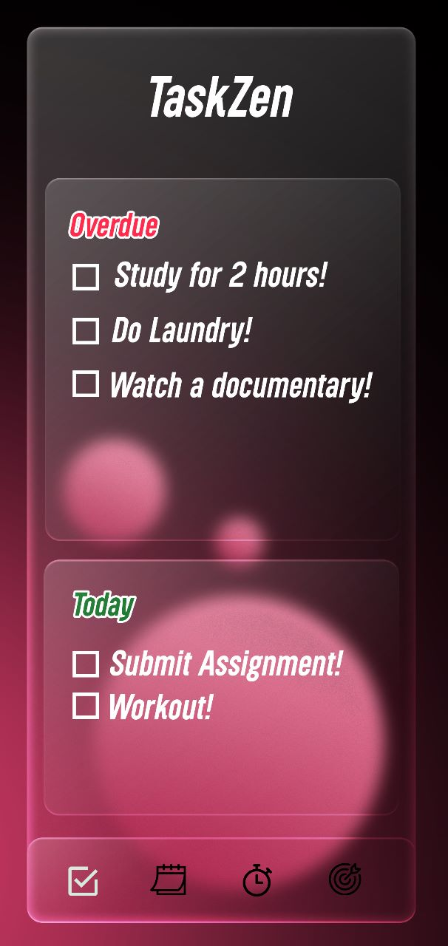
Stay on Top of Your Tasks
TaskZen's task management feature is designed to help you stay on top of your tasks and increase productivity.
Add task to your task list
Add reminder to your task
Add Due Date to your task
See your Overdue Tasks
See Upcoming Tasks
5

Slide 6
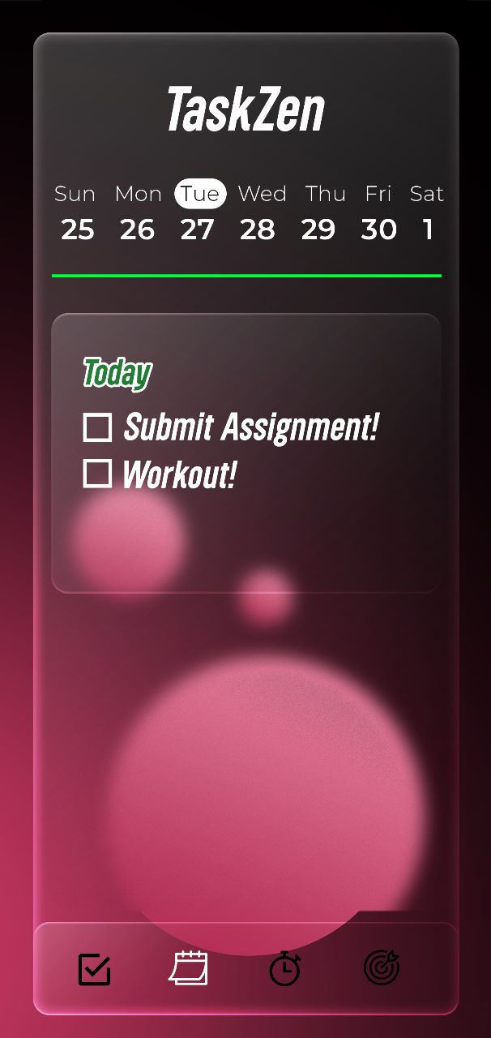
Manage tasks easily with sleek calendar visualization!
The calendar view in TaskZen is a powerful tool that allows you to see all your tasks at a glance.
See all overdue, upcoming and day to day tasks at a glance in a calendar view
Also lets you easily add new tasks.
You can set the task's due date, priority level, and even assign it to a specific project.
8

Slide 7
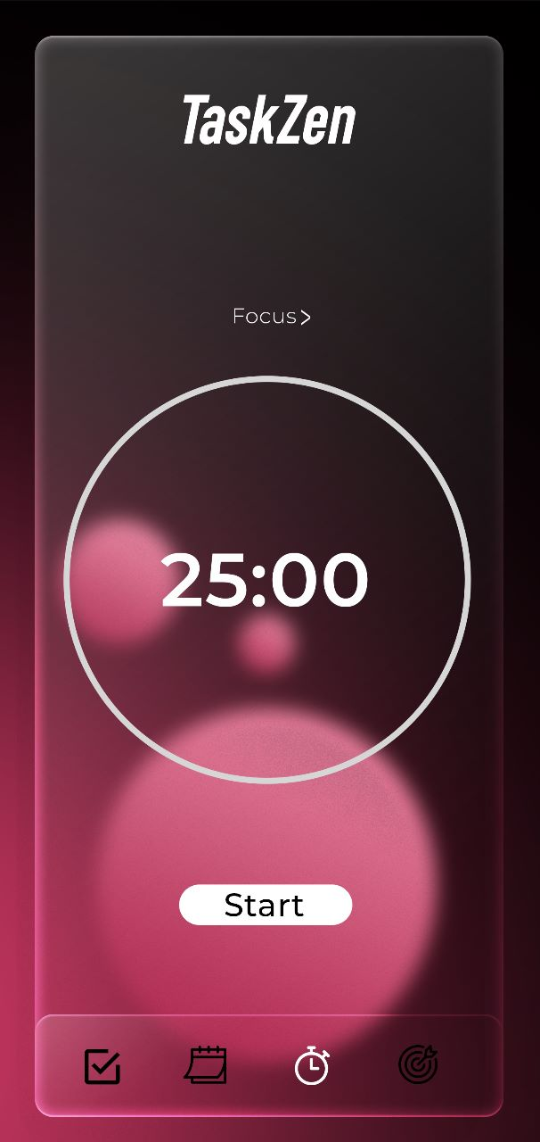
Get in the Zone with the Pomodoro Timer
The Pomodoro technique is a time management method that involves breaking down work into intervals, traditionally 25 minutes in length, separated by short breaks. This technique has been proven to increase productivity and focus.
Implement pomodoro technique to your workflow
You can customize the length of the intervals and breaks to suit your preferences and work style.
7

Slide 8
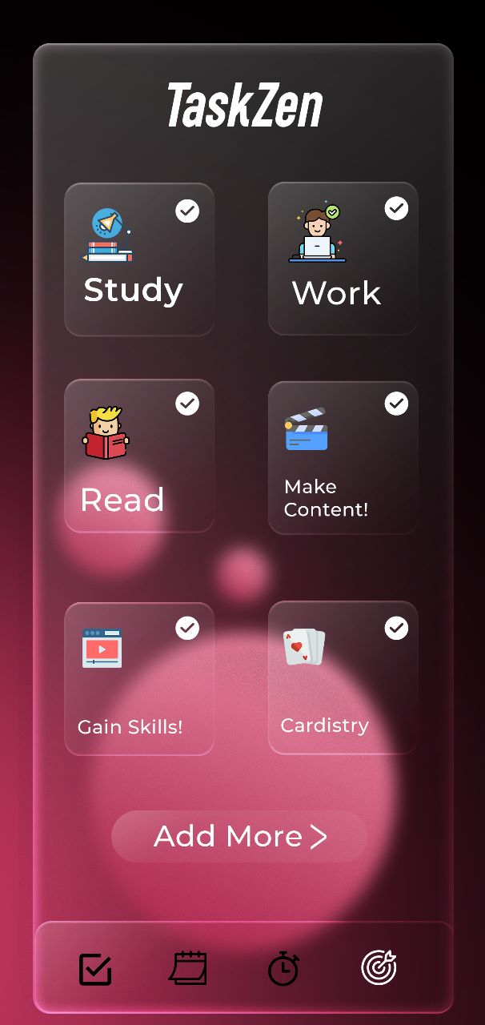
Track Your Habits and Build Streaks
TaskZen's habit tracker feature is a powerful tool to help you build better habits and achieve your goals.
Add Habits to Track
Maintain Streak
Make more actions to habit to achieve personal goals
6

Slide 9
Some Extra Features
Add due date to tasks
Priority Assign
Task reminder
Customize the length of intervals
9

Slide 10
—David Allen
“Your mind is for having ideas, not holding them.”
10

Slide 11


Our team
Sharjil Shabab Khan
Manzar Nur Rahman Eftee
20210104108
20210104105
11

Slide 12
Thank you!
Do you have any questions?
12

